Slide 2
DIDACTIC MEETING FACULTY OF MANAGEMENT
Summer semester 2023/2024
23.02.2024

Slide 3
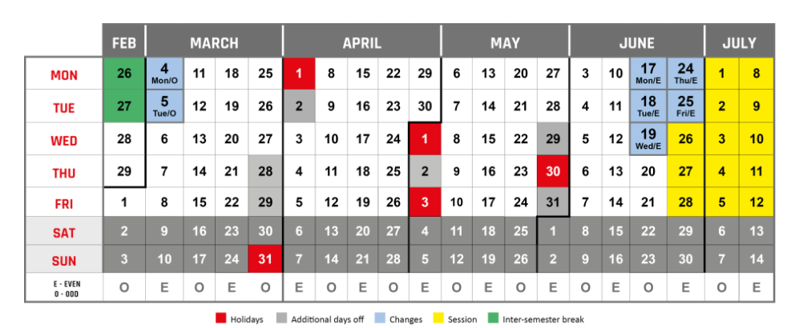
The Academic Calendar – Summer Semester 2023/2024

Slide 4
Organization of the summer semester 2023/2024
Organized classes start on 28th of February 2024 with an even week and run for 15 weeks (8 odd and 7 even numbered weeks) until 30th of September 2024.
CHANGES: from -28.02.2024 to 5.02.2024:
groups from odd weeks have only the first hour of class,
groups from even weeks have only the second hour of class.
The examination session lasts 13 working days and runs from 26 June 2024 to 13 July 2024, plus three Saturdays (29 June, 6 July, 13 July 2024).

Slide 5
Mode of work in the summer semester
All classes in the summer semester 2023/2024 are going to be organized in F2F mode (in campus).
Exceptions to this are subjects whose remote mode of implementation is due to the curriculum or students' request before the beginning of the semester (with the approval of the lecturers).
All scheduled classes must be completed. In case of justified absence there two options:
Conducting the class at a different time (agreement about date with students).
Conducting the class on the shceduled time by another teacher (instead).
Regular reporting of absences and substitutions, including sick leave is requested to the Head of Department!

Slide 6
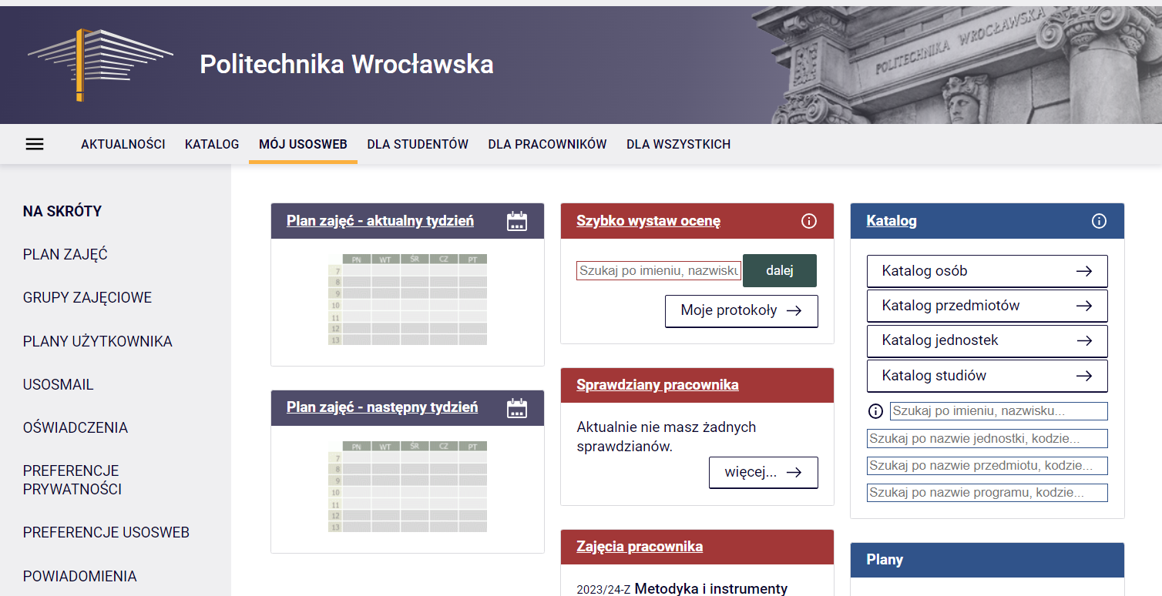
Work mode - USOS
Check your courses schedule in USOS (active directory credential)
Keep an eye on the number of your diploma thesis
Keep an eye on reporting your absences (TETA)
Report class collisions )if any( in classrooms and schedules
Create subjects from USOS on eportal.pwr.edu.pl

Slide 7
Organization of the first classes
In accordance with the Study Regulations (par. 16, ust. 4):
The course facilitator shall, during the first class of the semester (teaching period), inform the students about:
detailed rules for passing the course,
rules on attendance, including the limit of allowed absences from classes, the procedure for excusing absences, and the way in which absences are made up, subject to the rules laid down in sec. 8,
the forms, manner and rules for the validation of achievements of learning outcomes, including possible conditions for admission to examinations,
rules for communicating about grades
Scheduled office hours for students, (delivery of information about scheduled office hours is requested – Head of Department – deadline the end of 2nd week of semester)

Slide 8
Schedule of educational (supporting) activities for summer semester 2023/2024
by 12.03
Signing by the academic teachers and doctoral students the teaching pre-assignments for the summer semester 2023/2024
by 15.03
Providing information about scheduled office hours to Ms Anna Stembalska anna.stembalska@pwr.edu.pl
by 27.03
Communication of Framework Schedule of Class Inspections to the public
01.04-17.05
Signing by the academic teachers and doctoral students the final teaching assignments for the summer semester 2023/2024 in the dean's office
Teaching assignments must be signed in person!
The Class Inspections Teams conduct inspection’s visits
by 12.07

Slide 9
Didactic schedule – summer semester 2023/2024
Entering evaluation into the USOS system
Grades until 25.06.2024
Thesis evaluation until 25.06.2024
Exams until 13.07.2024
In accordance with the Study Regulations, § 20 p. 7.
"After the grade has been issued in the information and communication system, the student may confirm or, within two working days of its issue, submit a complaint to the coordinator. The coordinator shall, within two working days of the complaint, correct the grade, if any."

Slide 10
Office hours for students
An academic staff member employed in a research-teaching position and teaching position:
up to 5 teaching hours per week- 2 hours per week,
above 5 hours of classes - 4 hours per week
The duration of office hours in one day cannot be shorter than 1 hour, conducted without a break, and no longer than 3 hours.
Office hours can be conducted in remote, synchronous mode up to 50% of the total scheduled office hours in the campus.

Slide 11
Diploma theses - calculation hours
8 hours for engineering thesis supervision,
8 hours for a bachelor's thesis supervision,
12 hours for supervising a Master's thesis
(6hrs Diploma Thesis I + 6hrs Diploma Thesis II)
The total number of calculation hours for the diploma thesis may not exceed 120 hour annually for all theses.
in exceptional cases, with the approval of the Vice-Rector responsible for education, the number of calculation hours for thesis supervision for a given supervisor may be raised to 180 hours per year.
Keep an eye on your number of diploma thesis!

Slide 12
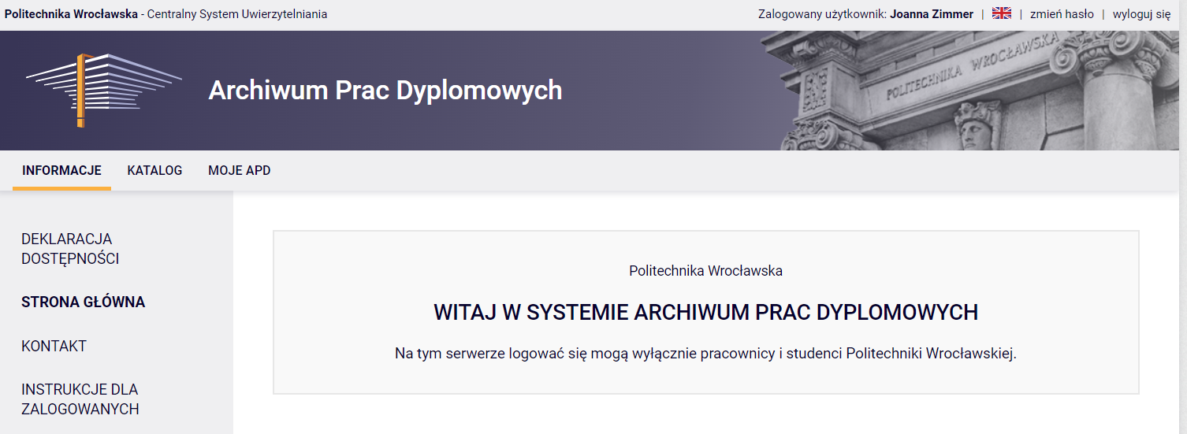
Process for submitting a thesis subject
1. Submission of proposed topics for diploma theses in the APD system
3. Selection of thesis topics by the student from the proposal (APD topics catalog)
4. Specifying the topic of the diploma thesis with a student (edition of the topic in APD)
6. Acceptance of the thesis topic by the Program Committee in the APD system
5. Submitting the subject of the diploma thesis to KP by the supervisor in the APD system
2. Verification of the proposed topics by the Plenipotentiaries for the field of study

Slide 13
Differences between diploma theses
Criterion | Diploma thesis (licencjat) | Diploma thesis (inżynier) | Master’s thesis
Nature of work | Case study / comparative analysis / in-depth diagnosis / project | Project | Has features of scientific work
Purpose of the work | Practical purpose | Practical objective requiring an engineering approach or the use of technical means | Objective of a research character
Scope of work | Requires the use of typical methods to diagnose, identify and solve a management problem | Requires the use of IT or quantitative methods / techniques / tools to solve a management problem | Requires the use of appropriate research methods (including literature review) to solve the problem posed
Depth of description, domain knowledge | Discussion of methods / techniques / tools / management concepts adequate to the problem and scope of the work and broader description of methods / techniques / tools / management concepts selected to realize the aim of the work | Discussion of methods / techniques / tools adequate to the problem and scope of the work and broader description of methods / techniques / tools selected to realize the aim of the work | Critical analysis of literature sources, author’s description of the research problem, its solution and method of verification
Selection of sources | Specialized literature concerning the field knowledge - several items, mainly books and journals | Specialized literature concerning the field knowledge - several items, mainly books and journals | Extensive literature, also in foreign languages. Reliable and varied sources, including scientific ones

Slide 14
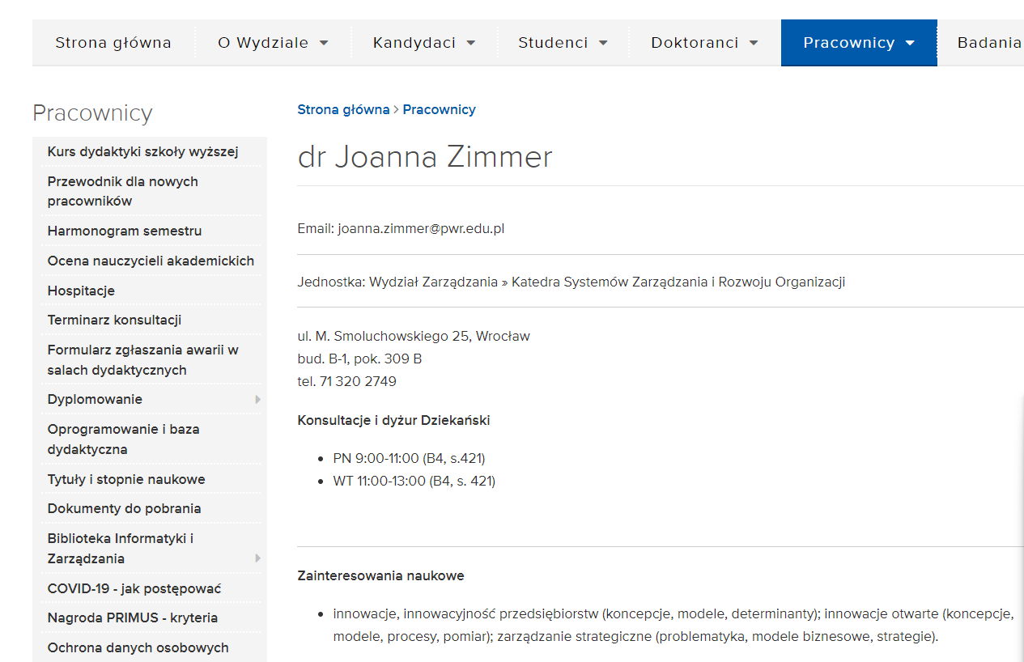
On-site visit of the Polish Accreditation Committee - PKA!!!
On-site visit in Q2 2024 at the Faculty of Management;
Starting and finishing classes on time;
Thorough verification of learning outcomes in subjects and collection of documentation;
updating the employee cards;
and others…..

Slide 15
Thank you for your attention
Joanna Zimmer
Vice Dean for Education
Pok. 4.21 B-4
Tel. + 723 033 048

